Slide 1

Types of Machine Learning
Presented by:
Elizer Ponio Jr.
Department of Computer Science
College of Computing and Information Technologies

Slide 2
Outline
Different Types of Machine Learning
Definitions
Algorithms
Applications
Notes:
Have you asked yourself the question, why do people organize?
Lets go to the psychology of organizing
This predictability applies within the context of our homes, manifesting through the concept of organization

Slide 3
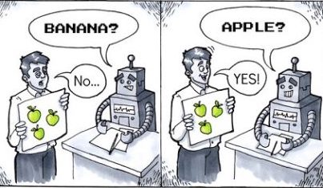
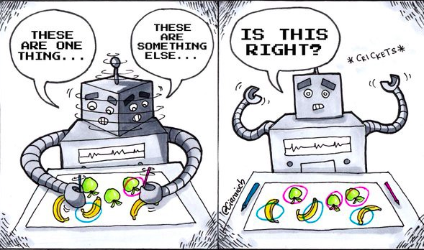

Types of Machine Learning
Supervised Learning
Unsupervised Learning
Reinforcement Learning
Notes:
Have you asked yourself the question, why do people organize?
Lets go to the psychology of organizing
This predictability applies within the context of our homes, manifesting through the concept of organization

Slide 4



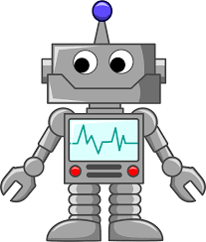


Definitions
Supervised Learning | Unsupervised Learning | Reinforcement Learning
Supervised Learning is used to train machines using labeled data | Unsupervised learning used unlabeled data to train machines | Reinforcement Learning uses an agent and an environment to produce and action and a reward
Apple
???
Mango
Grapes
???
???
Notes:
Have you asked yourself the question, why do people organize?
Lets go to the psychology of organizing
This predictability applies within the context of our homes, manifesting through the concept of organization

Slide 5
Algorithms
Supervised Learning | Unsupervised Learning | Reinforcement Learning
K-Nearest Neighbor
K Means Clustering
Monte-Carlo
Linear Regression
Hierarchical Clustering
Temporal Difference
Logistic Regression
DBSCAN
Q-Learning
Support Vector Machines
Principal Component Analysis
Dynamic Programming
Decision Tree
Notes:
Have you asked yourself the question, why do people organize?
Lets go to the psychology of organizing
This predictability applies within the context of our homes, manifesting through the concept of organization

Slide 6
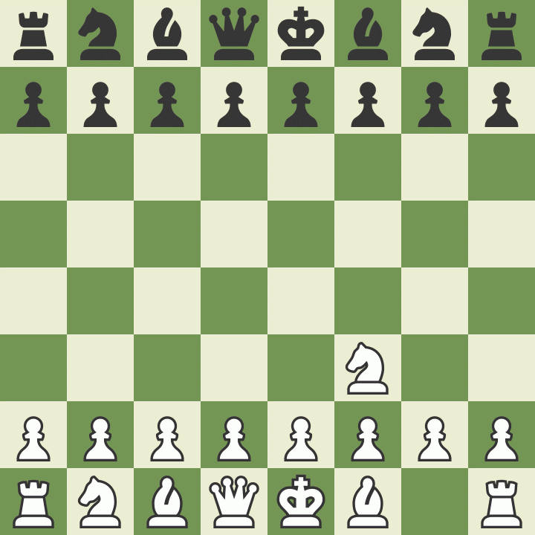




Applications
Supervised Learning | Unsupervised Learning | Reinforcement Learning
Stock Prediction
Chess
Malware analysis
Sentiment Analysis
Dota 2
Notes:
Have you asked yourself the question, why do people organize?
Lets go to the psychology of organizing
This predictability applies within the context of our homes, manifesting through the concept of organization

